Slide 1
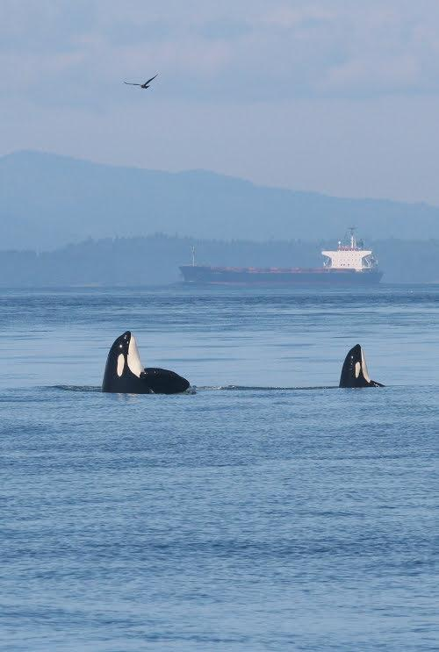
Real-time detection and classification of underwater soundscape signals via a
convolutional autoencoder
Val Veirs and Scott Veirs
Orcasound.net
vveirs and sveirs @ gmail

Slide 2
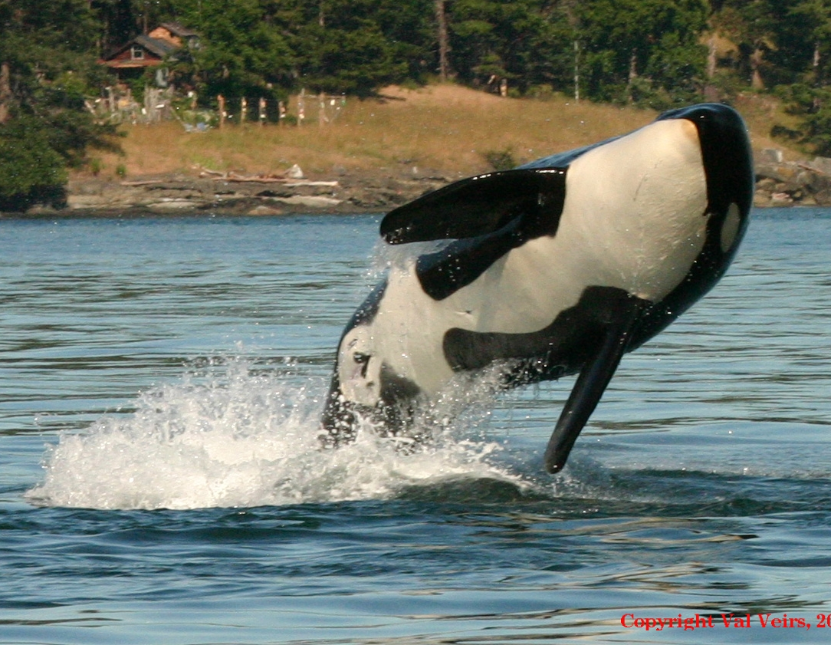
Our orcas: the southern salmon seekers
Southern Resident Killer Whales (SRKWs) are:
Southern = ranging from northern California to SE Alaska
Resident = historically re-occurring within the Salish Sea (inland waters of WA and BC)
Killer = apex predators, salmon specialists
Whales = cultural icons, both historically & as modern “charismatic megafauna”

Slide 3
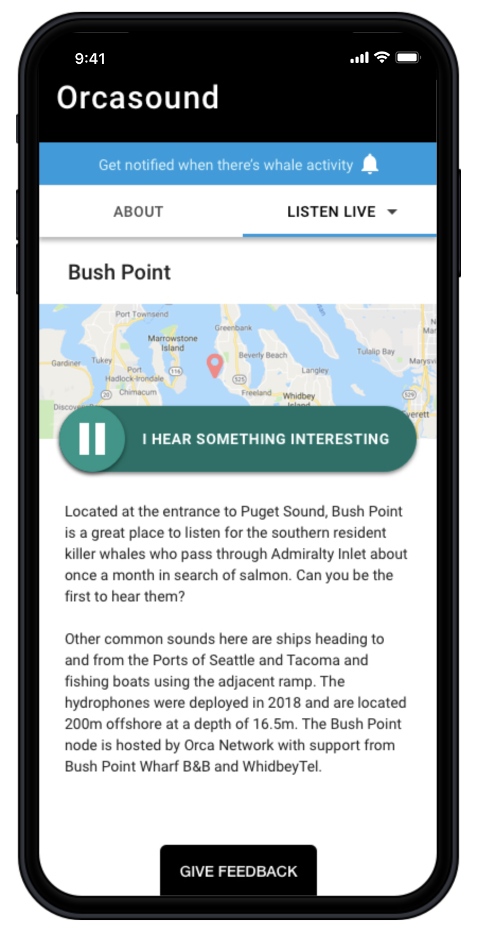
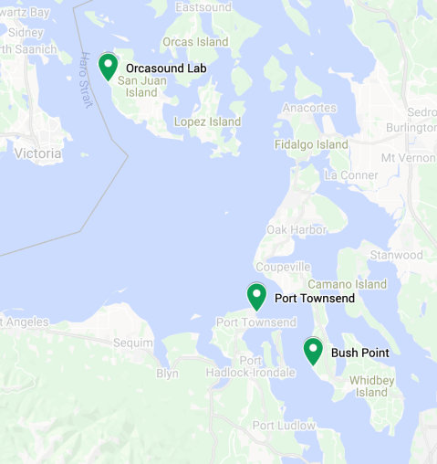
A hydrophone network (Puget Sound, WA, USA)
3 cabled nearshore sites streaming 24/7 in 2021
Community scientists detect orca sounds in real-time via a web app -- live.orcasound.net
AI is starting to listen, too -- ai4orcas.net
How can AI & human listeners understand soundscapes and advance marine bioacoustics?
Orca calls, whistles,
& clicks

Slide 4
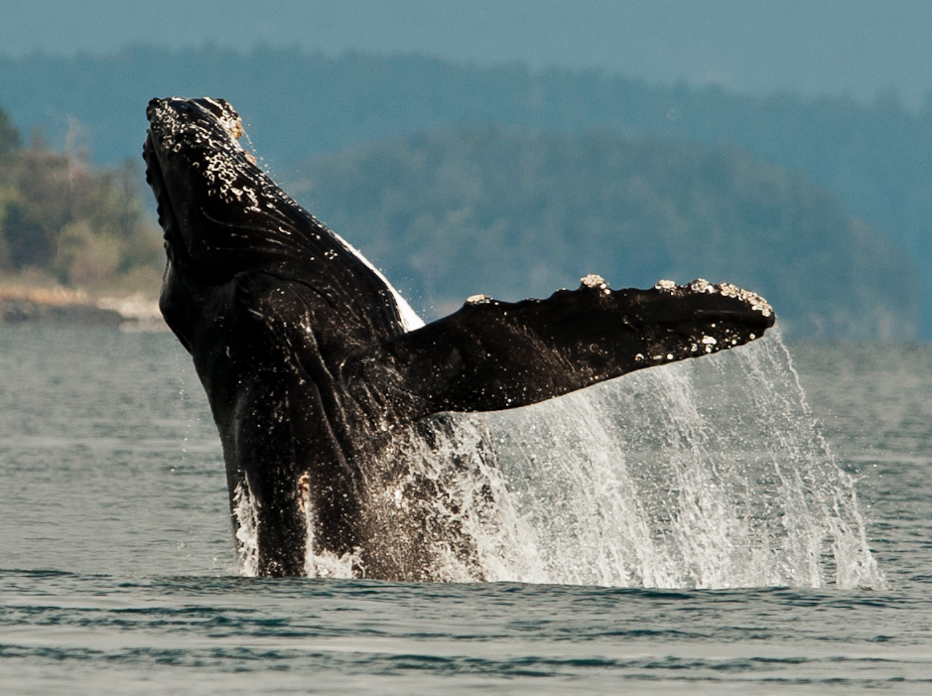
Can we automatically characterize the “Puget Soundscape” ?
Humpback non-song sounds: e.g. creaks, whoops, moans
Speed boats (~minutes)
Ships (~hour)
How can AI detect and classify this wide range of signals and noise?
Humpbacks
Ships
Boats

Slide 5
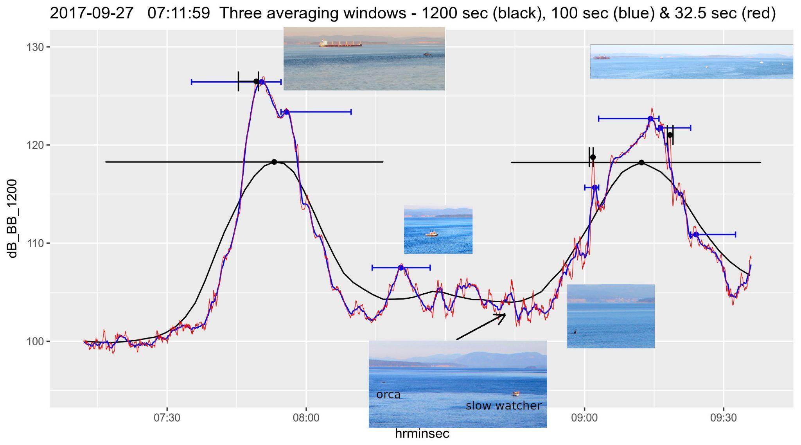
Averaging schemes for the time domain
Motivation for temporal averaging experiments
Averaging windows (factors of 8)
3, 24, 200, 1500 secs
4-hr windows
Common ML approach is fixed arrays (e.g. 3 seconds into a 128x128)

Slide 6
Motivations for an autoencoder (1)
An autoencoder is a type of artificial neural network used to learn efficient codings of unlabeled data (unsupervised learning).
Current Machine Learning applications here under the Salish Sea center on the detection of signals in categories that have been determined by trained listeners.
Large quantities of labeled data are used to train neural networks to detect signals such as orca calls.
To fully assess the soundscape, such a ML system would need labeled data for myriad sound categories from microsecond-long clicks to hour-long ship passages, etc.

Slide 7
Motivations for an autoencoder (2)
An autoencoder is a type of artificial neural network that extracts low dimensional ‘features’ from high dimensional signals.
These nonlinear features are measures of correlation between nearby regions in spectrograms (frequency vs time plots).
The features extracted from any spectrogram contain enough information to reconstruct the spectrogram to a reasonable degree.
These features can then be used as input to either supervised or non-supervised classifiers.

Slide 8
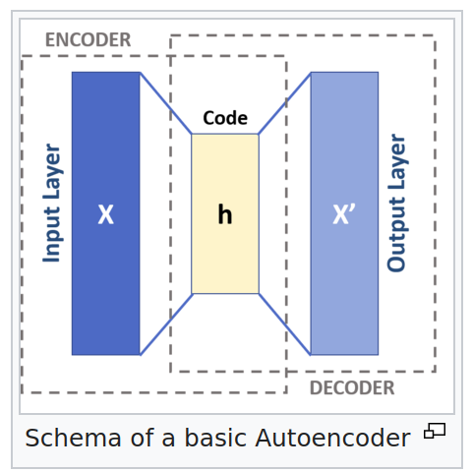
Motivations for an autoencoder
Autoencoder feature extraction is robust to variations in the input signal.
Since the autoencoder representation contains many fewer bits of information in any spectrogram, similar features are triggered by variations in the input signals.
This robust feature detection makes similar signals close together in feature space.
Extracting and Composing Robust Features with Denoising Autoencoders
http://dx.doi.org/10.1145/1390156.1390294
Wikipedia: Autoencoder

Slide 9
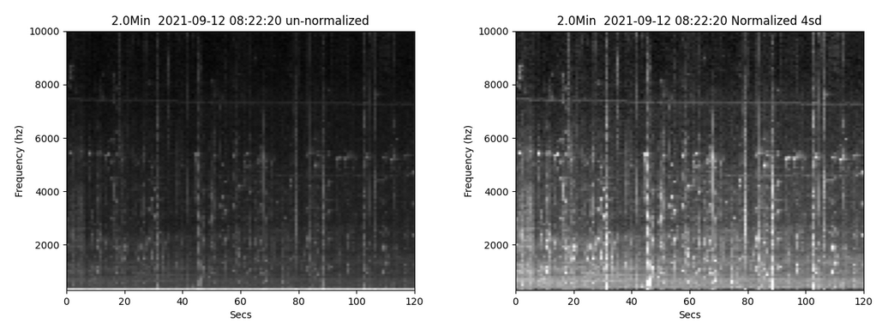
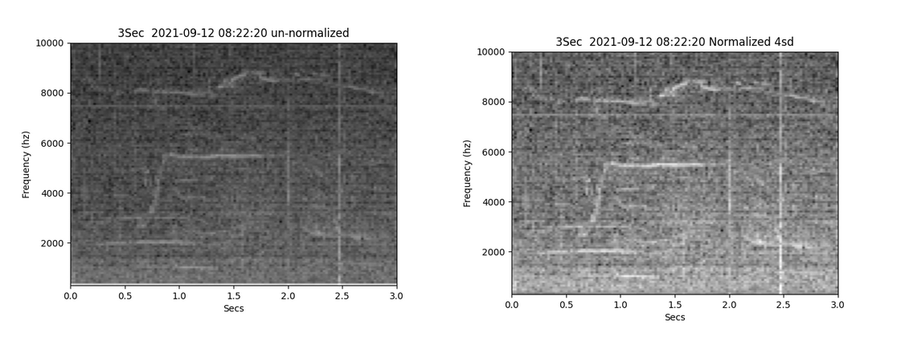
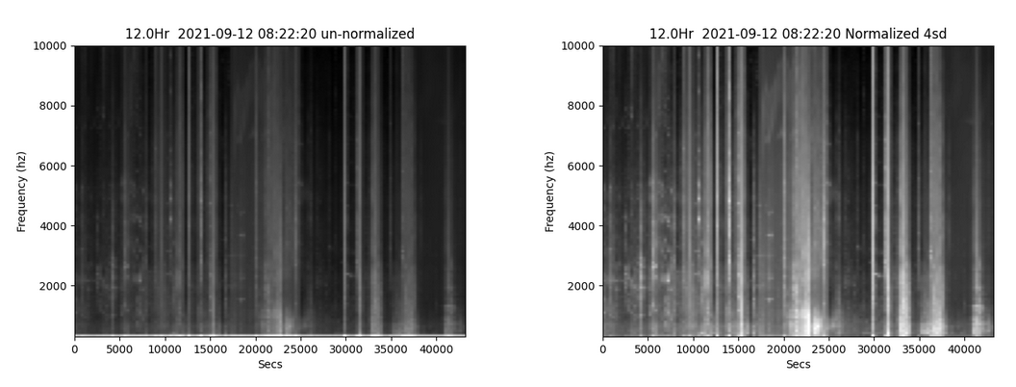
Methods: pre-processing
2 minute spectrograms
Fixed size arrays of power spectral density vs time - 128 x 128 psds
Various averaging times
Many Calls--
a Bout
3 second spectrograms
Un-normalized psd Normalized to mean += 3 stdev
1 hour spectrograms
Calls
Speedboats
Orca call

Slide 10
Methods: autoencoder description
Spectrogram: 16,384 values
Encoder Section - Keras Tensorflow
Acoustic pattern detector
Spectrogram input (128x128)
Choke point layer (8x8x32)
Layer sequence is reversed until the shape gets back to the original 128 x 128 array.
Enough information is ‘detected’ in the choke point that the original can be reconstructed!
Layer (type) Output Shape Param #
=====================================
input_1 (InputLayer) [(None, 128, 128, 1)] 0
conv2d (Conv2D) (None, 64, 64, 128) 1152
batch_normalization (None, 64, 64, 128) 512
re_lu (ReLU) (None, 64, 64, 128) 0
conv2d_1 (Conv2D) (None, 32, 32, 64) 73728
batch_normalization_1 (None, 32, 32, 64) 256
re_lu_1 (ReLU) (None, 32, 32, 64) 0
conv2d_2 (Conv2D) (None, 16, 16, 32) 18432
batch_normalization_2 (None, 16, 16, 32) 128
re_lu_2 (ReLU) (None, 16, 16, 32) 0
conv2d_3 (Conv2D) (None, 8, 8, 32) 9216
batch_normalization_3 (None, 8, 8, 32) 128
re_lu_3 (ReLU) (None, 8, 8, 32) 0
=================================================================
Total params: 103,552
Trainable params: 103,040
Features: 2048 values

Slide 11
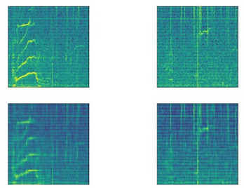
Methods: autoencoder training
3 sec
The autoencoder was trained on 15,000 spectrograms with averaging times of 3-sec to 1-hr.
Training is accomplished via Tensorflow (Google opensource) learning to create outputs that are as close as possible to the corresponding inputs.
No expert classes needed!
10 khz
Output Input
0
10 khz
0

Slide 12
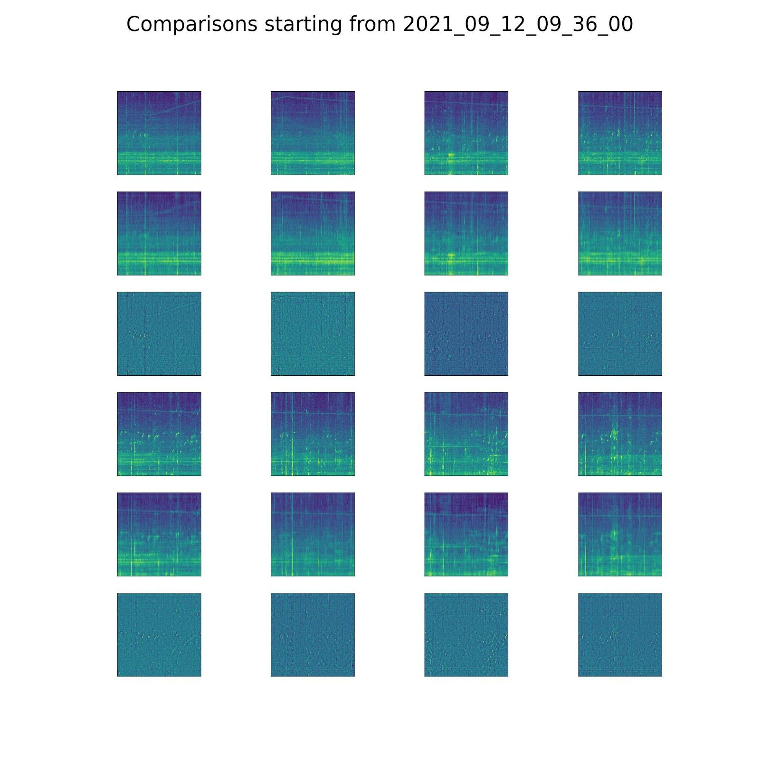
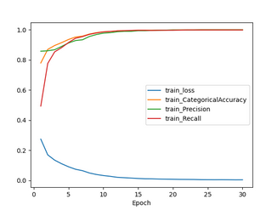
Results: low-loss signal encoding
60 second averaging
SRKW call autoencoding
Samples are de-noised
Residuals are minimal
Perhaps more training
will reduce these residuals?
Difference Output Input
Difference Output Input

Slide 13
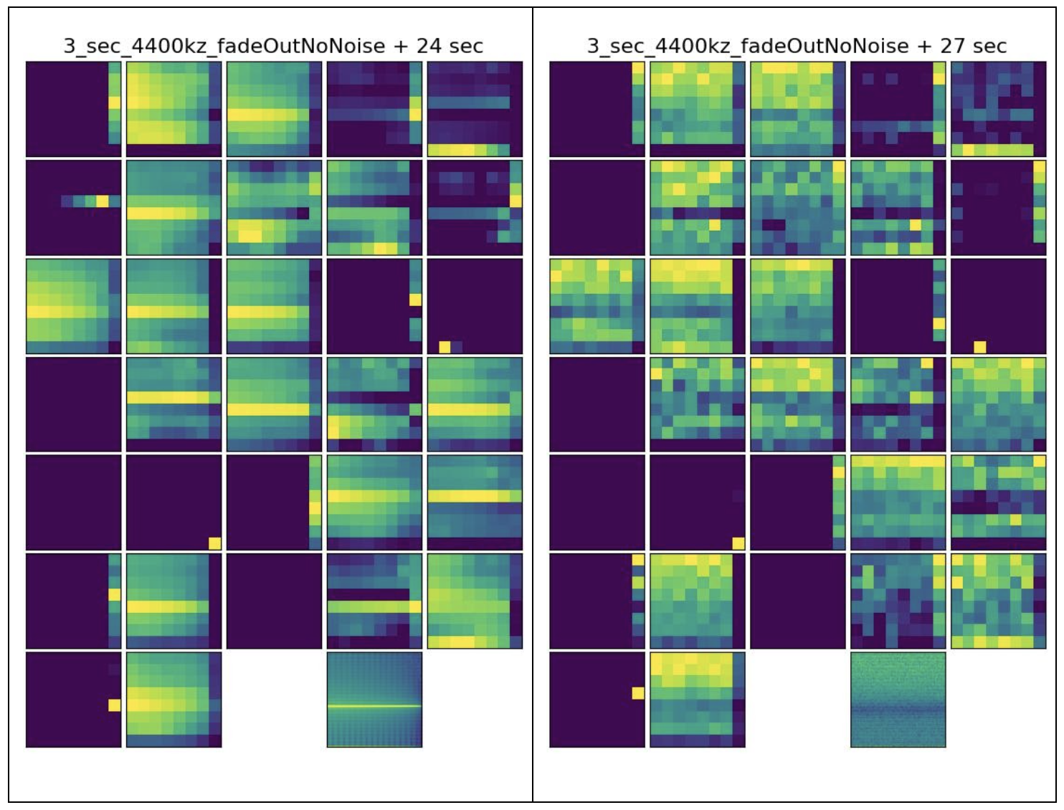
Encoder: synthetic signal vs no-signal
Bottleneck visualization:
4.4 kHZ tone
Amplitude fading to zero
No noise
Features have compressed the PSD data by a factor of 8!
Input spectrograms

Slide 14
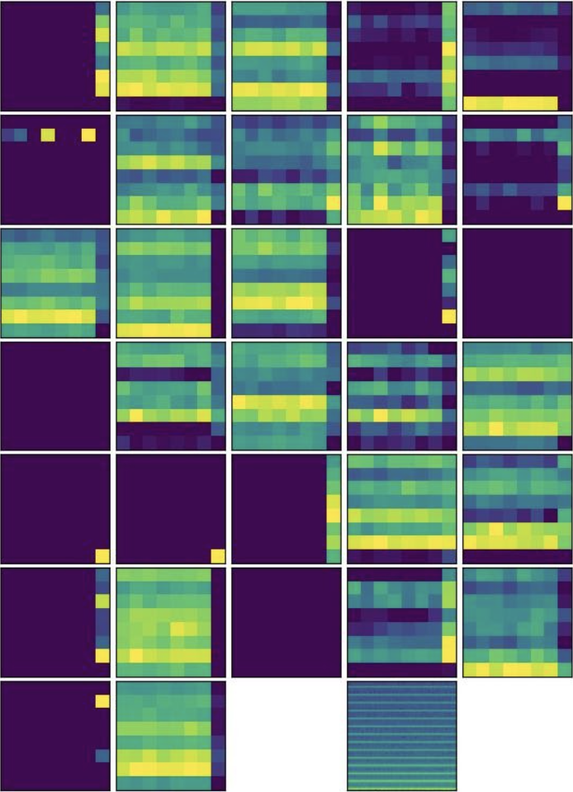
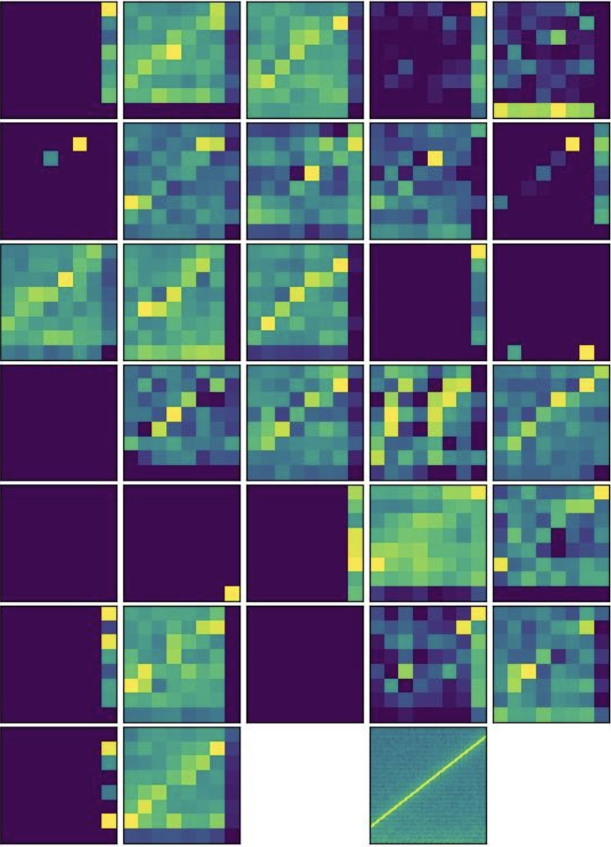
Encoder: synthetic signals
Input spectrograms
350 Hz, square, Brownian noise
Frequency ramp, steep slope

Slide 15
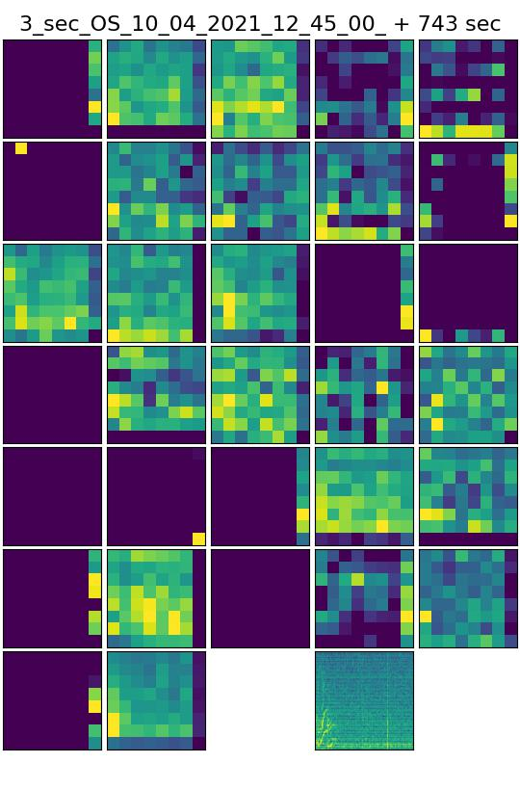
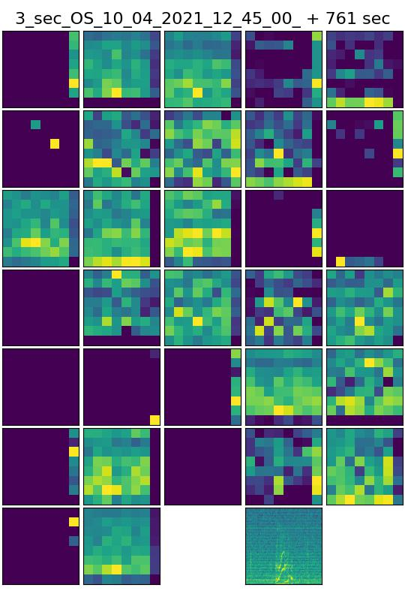
Features for some orca calls

Slide 16
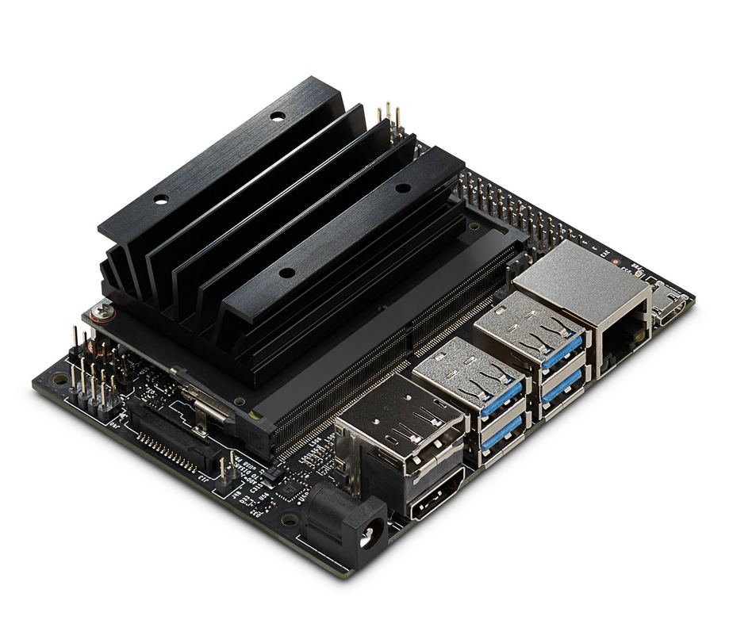
Next steps and applications:
Train autoencoder on a larger dataset
Implement clustering:
Supervised . . . CNN -> expert classes
Unsupervised . . . e.g. Random Forest
Compare results of direct spectrogram inputs vs the features extracted for each spectrogram.
Implement system on Jetson Nano running at the hydrophone feed at Orcasound Lab archiving and reporting cluster detections by cluster class.
A take-home thought

Slide 17
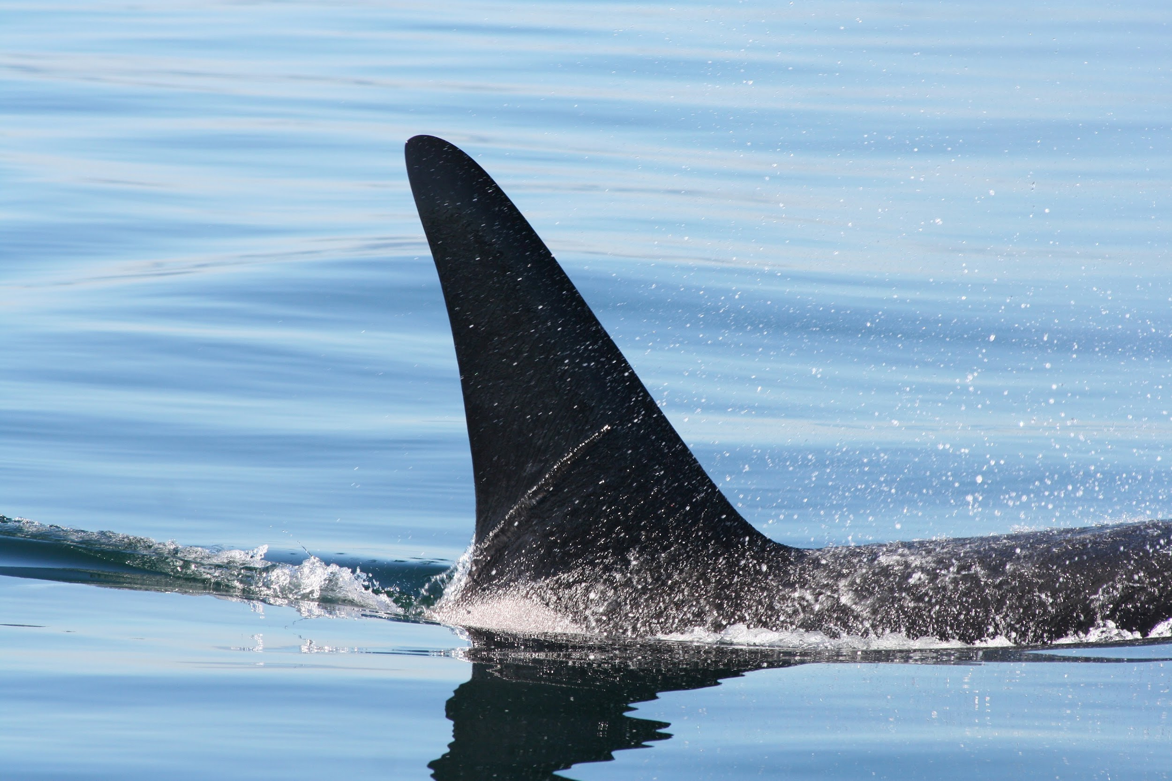
Acknowledgements & links
Give orcas a voice! live.orcasound.net
Thanks to all our collaborators!
The Orcasound open source community’s volunteer hackers
The many NGOs & volunteers who maintain the hydrophones at each node
Oliver Kirsebom & Fábio Frazão et al. at Meridian teaching us about open source deep learning
Explore the soundscape, AI, & code :
orcasound.net/learn
ai4orcas.net
github.com/orcasound

Slide 19
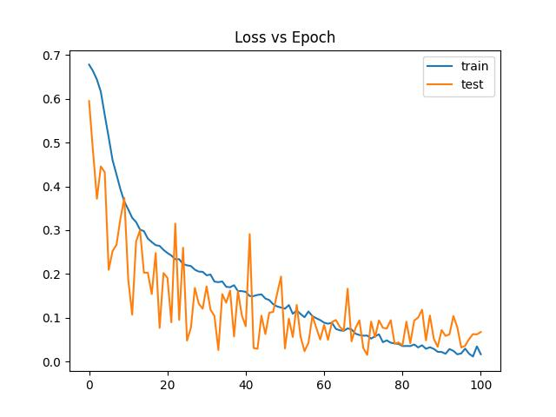
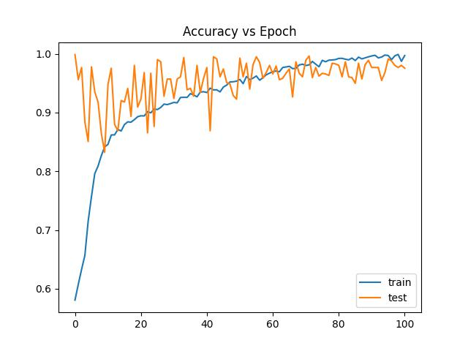
Preliminary classifier results...
Pod.cast annotations of SRKW calls used to train binary classifier
Inputs to classifier are features from the autoencoder’s encoder section.

Slide 20
Artificial Intelligence for orcas
AI for orcas (#ai4orcas) -- ai4orcas.net
towards (more) open (marine) bioacoustic data science...

